Slide 1


A Survey on Volunteer Management Systems
Hawaii International Conference on System Sciences
HICSS-49
January 5-8, 2016 Grand Hyatt, Kauai
Markus Raab
Johannes Schönböck, Josef Altmann, Elisabeth Kapsammer, Angelika Kusel, Birgit Pröll, Werner Retschitzegger, Wieland Schwinger
Notes:
Introduction:
I am …
We are ...
I want to talk about ...

Slide 2
A Survey on Volunteer Management Systems
Markus Raab, January 6th, 2016
Johannes Schönböck, Josef Altmann, Elisabeth Kapsammer, Angelika Kusel, Birgit Pröll, Werner Retschitzegger, Wieland Schwinger

Slide 3
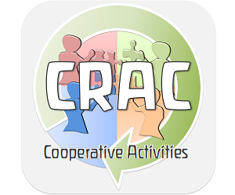
Objectives
Foundation: “CrAc – Cooperative Activities”
  2 partners who rely on voluntary work / volunteers
  Need for coordination and management
Analyze individual situations of project partners and identify requirements
Investigate functional commonalities & differences of available VMS *
Identify challenges of VMS
Develop reference model (RM) of VMS capturing functional components in UML class diagrams
*) VMS = Volunteer Management Systems
RM = Reference Modell
Notes:
Ad 4: bottom up, top down

Slide 4
Objectives
Operationalize RM to compare and evaluate seven VMS
  Demonstrate the applicability of the RM
  Discuss peculiarities, shortcomings of VMS
  Identify future research direction and development of prototype

Slide 5
Voluntary Work
Important contribution to society
  Includes service and charitable activities (e.g. health care, emergency management, social services, education)
  Expressive activities in sports, art, culture, etc.
NPOs – Non Profit Organizations
Open Source Communities
Associations & clubs
…

Slide 6
10% of workforce
Notes:
Worldwide voluntary work adds up to 10% of the workforce

Slide 7
25%

Slide 8
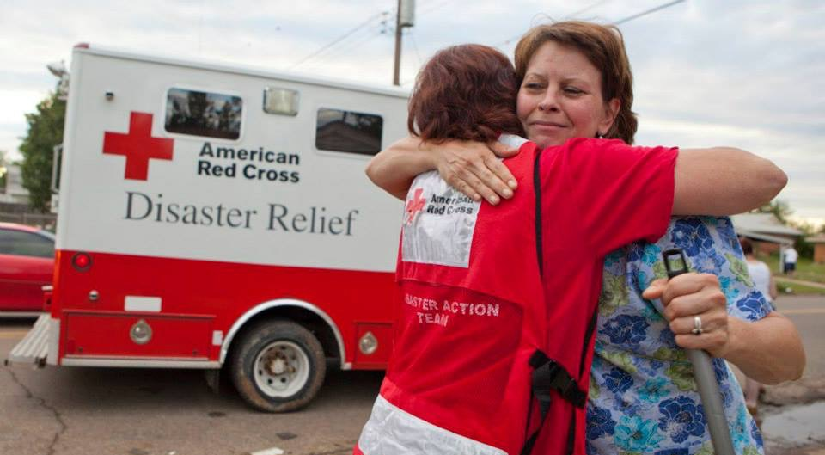

Slide 10
Notes:
War in Syria - refuge crisis – huge impact – without volunteers impossible to handle

Slide 11

Notes:
Natural disaster

Slide 12
Notes:
Outbreak of fire: 1) fire service (professionals), but 2) also volunteer fire department

Slide 13
Notes:
Take care of elderly
Educate next generation
Support sportsmen, sportswomen and athlete
Any other voluntary organization: local or worldwide

Slide 14
How to fulfill voluntary work?
Online – offline
Onsite – remote
Occasionally – long term
Trivial – special competencies
No ongoing commitment – permanent commitment
Notes:
No ongoing commitment e.g. Crowdworking (tasks are fulfilled online), Micro-Volunteering

Slide 15
Voluntary Work
Vast range of tasks & different intensity of engagement
  Common mind-set (collective conservation of value) and similar interests of the volunteers
Unsalaried & cooperative activities
Small, informal groups at a local level
Large, globally acting organizations, e.g. Red Cross
Generates profitability and „Economic Value Added“
Should be supported through ICT → VMS

Slide 16
Volunteer Management Systems (VMS)
ICT major enabler of volunteering processes (UN Worlds Volunteerism Report)
VMS connect potential volunteers with volunteering opportunities
  Scheduling, allocation and execution of tasks
  Providing communication and coordination mechanisms for collaboration and cooperation
  Facilitating assessment and motivation strategies
User- and task management for exceptional circumstances
Notes:
VMS handles arising work in voluntary organizations
VMS bring together volunteers with vol. opportunities: 1) within an organization, beyond an the border of an organization

Slide 17
Volunteer Management Systems (VMS)
Efficient, suitable and balanced distribution of cooperative activities
  Positive effects for individual volunteer‘s motivation
  Positive effects on profitability offered services
  Positive consequences to the society as a whole
Vast number of VMS exist
Most commercial with different goals, exhibiting different functionality to support the phases of a volunteering process
→ Challenges of VMS
Notes:
Efficient …. Leads to …. 1) ... 2) ... 3) ...
Insufficient system support prevents an efficient, adequate and balanced task distribution
This situation decreases the motivation for task fulfilment and the quality of services

Slide 18
Challenges of VMS
based on analysis with project partners
Challenges of VMS
Inhomogeneous conglomerate of resources and tasks
Flexible allocation allowing brokerage and negotiation
Adaptation- and motivation-oriented assessment
Continuous evolution
Notes:
Classified into 4 groups
Based on analysis with project partners

Slide 19
Inhomogeneous Conglomerate of Resources and Tasks
Challenges of VMS
Inhomogeneous conglomerate of resources and tasks
Flexible allocation allowing brokerage and negotiation
Adaptation- and motivation-oriented assessment
Continuous evolution
HR
  Diverse competencies, interests as well as personalities of volunteers are prerequisite for appropriate task allocation (which may lead to increased intrinsic motivation)
  No pre-defined hierarchical structures → VMS should support dynamic team building for conducting more complex and possibly ad-hoc tasks
NHR
  Necessary to achieve certain tasks (e.g. specific equipment)
  Provided by organization or volunteer
Notes:
Stated by our project partners
Different kind of resources and tasks, don’t follow the same structure, but still needs to be managed and matched somehow
HR 1) Prerequisite for appropriate task allocation = competencies, interests, personalities, etc. but also location, availability, experience, social connections, previous results (assessment), …
HR 2) Voluntary organizations have less pre-defined hierarchical structures → need for dynamic team building
NHR 1) Necessary to achieve certain tasks
NHR 2) Provided by organization or volunteer

Slide 20
Inhomogeneous Conglomerate of Resources and Tasks
Challenges of VMS
Inhomogeneous conglomerate of resources and tasks
Flexible allocation allowing brokerage and negotiation
Adaptation- and motivation-oriented assessment
Continuous evolution
Break down tasks into appropriate granularity
Sophisticated workflow execution mechanism at runtime
  Structural relations (composition of tasks)
  Behavioral relations (task control flow)
Not fully pre-planned → adapt workflow definitions at runtime
Introduce ad-hoc tasks and workflows dynamically, not only in a central way but also decentralized by the volunteer
Notes:
Stated by our project partners

Slide 21
Flexible Allocation Allowing
Brokerage and Negotiation
Challenges of VMS
Inhomogeneous conglomerate of resources and tasks
Flexible allocation allowing brokerage and negotiation
Adaptation- and motivation-oriented assessment
Continuous evolution
Volunteers should be allocated to tasks that match their personal profile
Keep volunteers motivated plays key role → achieve sustainable commitment of volunteers over time
Simple mechanisms, e.g. role-based assignments may not be sufficient
Matching strategies
Task allocation through push and pull principle
Brokerage and negotiation
Notes:
Allocation and matching – find the best volunteer or group of volunteers for a task
Brokerage / negotiate = exchange task

Slide 22
Adaptation- and Motivation-
Oriented Assessment
Challenges of VMS
Inhomogeneous conglomerate of resources and tasks
Flexible allocation allowing brokerage and negotiation
Adaptation- and motivation-oriented assessment
Continuous evolution
Crucial in order to identify potential improvements
Allow assessment by different stakeholders
Target of assessment
  Volunteers themselves (e.g. their engagement)
  Tasks (e.g. their complexity or outcome)
  Appropriateness of task allocation
  Long-term social aspects (satisfaction or gain of expertise)
Notes:
Adaptation-oriented Assessment =
Motivation-oriented Assessment =

Slide 23
Continuous Evolution
Challenges of VMS
Inhomogeneous conglomerate of resources and tasks
Flexible allocation allowing brokerage and negotiation
Adaptation- and motivation-oriented assessment
Continuous evolution
Continuous improvement of the voluntary process
Appropriate adaption of various aspects / data
  Adapting resources (achievements of a volunteer)
  Task perspective (extending, merging or decomposing a task into subtask)
  Allocation of tasks
  Building of teams
Suitable motivation strategies have to be provided (e.g. awards, rankings, gamification elements)
Notes:
Allocation / matching method should be dynamic
Building of teams: e.g. a volunteer is over strained by a task or disappointed in a certain team

Slide 24
Reference Modell (RM) for VMS
Goal: Outline core artifacts of VMS and their interrelationships in term of UML class diagrams
Approach is twofold
  Top-down manner, i.e. incorporating related work from diverse research areas relevant for the RM
  Bottom-up manner, i.e. concepts from existing VMS, requirements identified from the VIOs (Volunteer Involving Organizations) involved in our research project
Notes:
Top-down manner: e.g. existing (meta-)models for CSCW, competencies, workflows

Slide 25
RM > Volunteer Management System (VMS)
Notes:
Broke it down into Components and Process
Resources & tasks are the central artifacts within a VMS

Slide 26
RM > VMS Components

Slide 27
RM > VMS Components > Resources
Resource = source or supply from which benefit is produced
Resource should be as domain-independent and generic as possible
Resource further described by Profiles and according Features
Resources related to each other explicated by the relationship class ResourceRelationship
  Structural relationships, e.g. teams of volunteers, membership, own equipment, etc.
Notes:
NonVolunteers = e.g. paid employees of the VIO
PhysicalResources = e.g. tools or vehicles
VirtualResources = e.g. guidelines, software, etc.

Slide 28
RM > VMS Components > Tasks
Tasks and their interdependencies, e.g. in terms of workflows essential for VMS
Defined most important task-categories for VMS
Tasks need to be coordinated across volunteers with different expertise and capabilities
TaskRelationships: StructuralTaskRelationships and BehavioralTaskRelationship
Required resources described by AllocationRelationship
Notes:
Humanity: HumanTasks require manual intervention by humans; NonHumanTasks can be executed automatically
Virtuality: VirtualTasks are online tasks which produces machine readable output
Predictability: PlannedTasks; AdHocTasks e.g. during runtime of other tasks
Commonality: CollaborativeTasks which are executed by several volunteers to achieve a common goal; CooperativeTasks are tasks executed together to achieve each volunteer’s goal
Locality: RemoteTasks are location-independent; OnSiteTask requires volunteer to be at a certain location
---
TaskRelationship is part of the Relationship class. Has subclasses Structural and Behavioral TaskRelationship.
StructuralTaskRelationship: allows composition of tasks, i.e. to represent dependent subtasks, versions of a task, and reuse of tasks by instantiation a new task based on an existing one.
BehavioralTaskRelationship: expresses typical behavioral dependencies, e.g. sequential or parallel task executions.

Slide 29
RM > VMS Components > Profiles

Slide 30
RM > VMS Components > Relationship

Slide 31
RM > VMS Process
States of a VMS process
  Allocation
  Execution
  Assessment
Communication
Notes:
States:
Communication: not only to announce the actual state of the volunteering process within a certain phase, but also to announce available resources (e.g. volunteers seeking for new volunteering opportunities) and available tasks.
Communication Rules: e.g. preferred channel is SMS, but after 10pm use email instead

Slide 32
RM > VMS Process > Allocation & Execution

Slide 33
RM > VMS Process > Assessment
Extensive demand for an assessment of the volunteering work
Resources - e.g. availability of non-human resources or the engagement of a volunteer
Allocation - the appropriateness of resources for a task or the suitability of a task with respect to a volunteer’s competencies
Task result - e.g. the (monetary) impact generated through a task conducted by a volunteer
Notes:
The inhomogeneous conglomerate of resources and tasks together with non-enforceable execution generate an extensive deman for an assessment of the volunteering work
Assessor can be a volunteer, a group of volunteers or an assessment algorithm
PostHoc: assessment after task execution
UpFront: assessment before runtime; focus on task preparation e.g. split work into fault-tolerant subtask
Review: results of the process
Audits: rules and regulations during conducting the process
Self assessment: volunteers assess themselves
External assessment: persons outside of the VIO, e.g. the beneficiaries of volunteer work conduct an assessment
Synchron: Feedback may be given when volunteers are still engaged in a set of tasks
Asynchron: Feedback when (part of) a task is completed)
Feedback: e.g. verbal
Rating: quantitative

Slide 34
RM > Evolution
Subsumes all activities that are required to continuously improve the volunteering work
Bases on the assessments available as resumes
Motivation
Adaptation
Notes:
Besides adaptation also motivational aspects are very important
MOTIVATION
Increase the intrinsic motivation of a volunteer
Preventing the de-motivation of volunteers
-> continuous necessity in VIOs
Motivation: broad spectrum of methods can be applied ranging from well known psychology and sociology approaches, to gamification, i.e. the use of gam thinking and game mechanics in non-game contexts to engage users in solving problems -> also supports again intrinsic motivation.
Appraisal: e.g. a simple “thank you-letter”
Awarding: e.g. “I volunteered” badge
Ranking: e.g. “best volunteer of the week”
IncentiveGranting: e.g. discounts granted by sponsors of the VIO or professional training courses
Challenging: e.g. raising the level of difficulty of tasks to address the playful nature of humans
Recruiting: e.g. broaden the basis of volunteers and thus to further increase the possibilities of social interaction (being another motivating factor in volunteering)
ADAPTATION
Evolve the diverse profile features of resources and tasks
Adapt a competence profile of a volunteer, as new competencies are gained when conducting a task (learning by doing)
Also: matching strategy and assignment methods may be adjusted such that they better “understand” the human nature of volunteering

Slide 35
Comparison of selected VMS
Nearly all existing systems supporting more or less the whole volunteering process are commercial ones
Selection of seven VMS
  Empirically evaluated as most used system (5 / 7 VMS)
  Web-based
  Possibility to manage HR (volunteers and organizational structures)

Slide 36
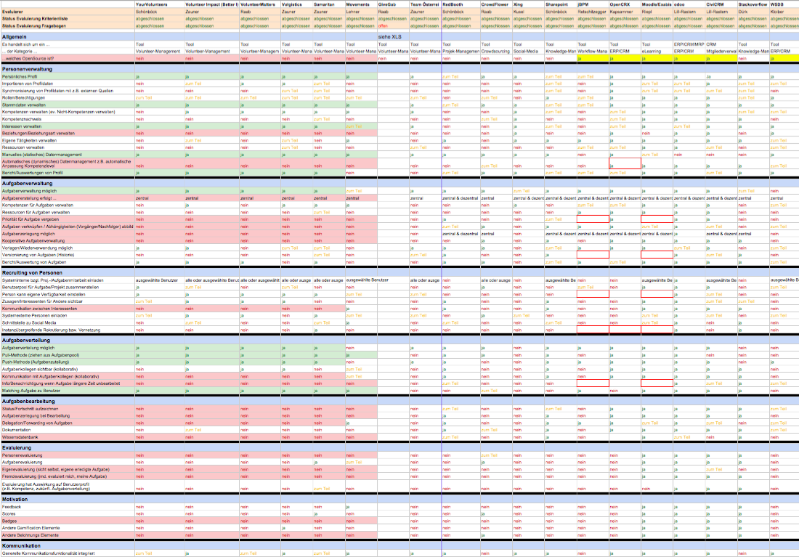
Analyzed 18 systems
Divided into approx. 80 criteria

Slide 37







Selected VMS
YourVolunteers
Volunteer Impact
VolunteerMatters
Volgistics
Samaritan
Movements
GiveGab
“social volunteering network”
Notes:
5 more traditional systems (management within an organization)
2 systems showing a different idea of voluntary management (‘brokerage’ and ‘social VMS’)
Samaritan: one of the most comprehensive and customizable VMS – also the priciest one
Movements: “brokering” platform, similar to eBay that enables the exchange of skills and resources. Users can post short briefs describing their projects, and providers can post offers of assistance describing their skills and ways in which they can help. Operational in the field of human rights.
GiveGab: app which can be considered as a “social volunteering network”, allowing to find local volunteering opportunities, also by connecting to friends, see where others are volunteering, and share volunteering experiences and impact with others.

Slide 38
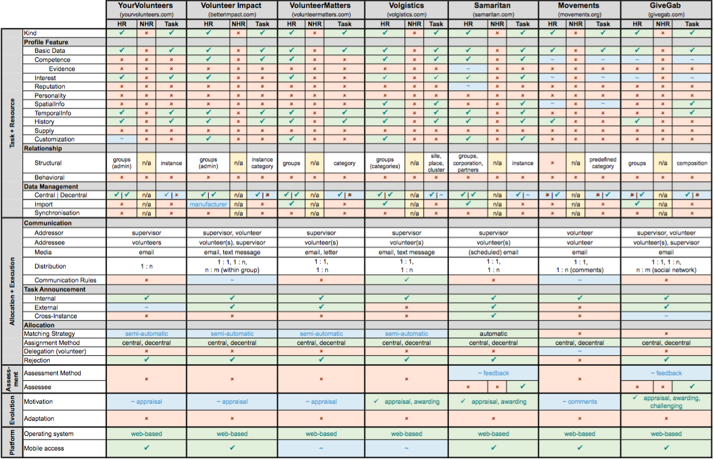
Report about each VMS
Evaluation table for comparison and findings
Notes:
Result:
Report about each VMS
Evaluation table for comparison and findings

Slide 39
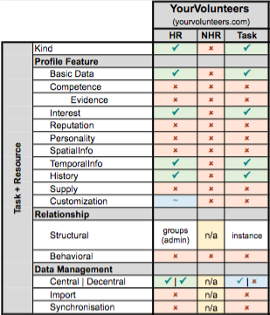
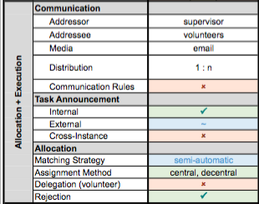
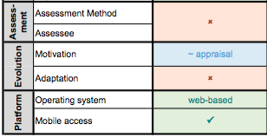
Criteria of Evaluation

Slide 40
Lessons learned
Limited profile coverage
Walled volunteering data islands
Limited support for complex tasks and social relationships
Limited communication
Suboptimal effectiveness and efficiency of allocation
Lack of assessment integration
Sparse support for motivation
Missing support for evolution

Slide 41


1. Limited Profile Coverage
Core functionality of managing human resources (i.e. volunteers) and tasks is achieved by all systems
  Basic data, competencies, interests, history data, temporal information
  Personality, reputation, resources that one could supply, spatial information that shares the location of task fulfillment or the volunteers possible operational range
No support to comprehensibly manage non-human resources
Customization partly possible
Systems do not base on standards or publicly available ontologies, hindering interoperability and extensibility

Slide 42
2. Walled Volunteering Data Islands
Central and decentralized data management for user profiles is provided
Shortage in interacting and incorporating external data and services
  Hardly support import of external data to incorporate data available in social networks, e.g. Facebook, LinkedIn
  Huge source of valuable data remains unexploited
  Synchronization lwith external data sources and social networks is neglected
Synchronization of contacts, tasks and appointments with a local database (e.g. smartphone) is not supported
➔ VMS should provide APIs, based on open standards (e.g. REST)
Notes:
Import of social media profiles would decrease the “cold-start” problem of properly describing resources (i.e. user profiles)
Synchronization with smartphone could open up interesting motivational aspects since the user does not have to interact with the system directly
APIs would allow seamless integration of data from external sources

Slide 43
3. Limited Support for Complex Tasks and Social Relationships
Available system can deal with simple (often online) tasks, which are often executed by a single person
Deficient in dealing with more complex tasks that require the consideration of special competencies, resources and dependencies between resources or tasks
Provide less means to manage relationships between resources and tasks
  Structural relationships (e.g. composing or decomposing of tasks)
  Behavioral relationships (e.g. dependencies)
Insufficient support in social relationships and knowledge among volunteers themselves
Notes:
Structural: composing, decomposing, versioning, instantiation (re-use)
Behavioral: Workflow (sequence, parallel, iteration)
Concretely, almost all approaches allow in some way a grouping of tasks or specifying task instantiations from templates, but none of the evaluated approaches provide means to specify behavioral relationships, which would be the prerequisite for comprehensive workflow support
With respect to volunteers, existing systems only support simple groups, but there is insufficient support, e.g. to deal with social relationships like knowledge of other volunteers or friendship, which could be used during the allocation phase.
Grouping of tasks mostly allowed, but shortage in behavioral relationships (for comprehensive workflow support)

Slide 44
4. Constrained Communication
Communication support is crucial in VMS
Most often constrained to one-to-many communication
  Supervisor (i.e. task creator) to the volunteer
  Insufficient for managing collaborative tasks
GiveGab (social volunteer) and Movements (brokerage) allow communication among volunteers (private messages, public comments)
Only 3 out of 7 systems support some kind of communication rules
Most systems support simple publishing of a task to social media, but only Samaritan supports sharing of tasks among different instances of the VMS
Notes:
Communication rules:
Whereas in VolunteerImpact it is only possible to enable or disable communication within a specified group, and in Movements the volunteer can only specify the regularity of notifications, Volgistics allows a more flexible approach, e.g., the volunteer can opt-in or opt-out text message reminders, set up a time frame for incomeing messages and even choose the category of messages, e.g. team leader (or supervisor) update or recruitment appeals, that should be forwarded.
A unified communication layer integrating all the existing communication features of the evaluated tools would be beneficial

Slide 45
5. Suboptimal Effectiveness and Efficiency of Allocation
Shortage in effectiveness and efficiency
  Resource and task allocation hampered by incomplete profile descriptions (necessary for matching the most appropriate task)
Maximum semi-automatic task assignment (supervisor can filter tasks based on the resources’ attributes → needs knowledge of the tasks’ requirements)
Improvement of current situation for use in large-scale organizations: Intelligent matching strategies in form of semantic descriptions needed (with respect to competencies, interests, personality, reputation, etc.)

Slide 46
6. Lack of Assessment Integration
Hardly considered at all by existing systems (Samaritan and GiveGab provide basic support via surveys on the fulfilled task)
  Assessment after task fulfillment only
Full spectrum of assessment c.f. RM
  UpFront, PostHoc, etc.
Proper assessment phase
  Feedback to volunteer, supervisor and the system
  Use results for further improvements – benefit through evolution (in terms of motivation and adaptation)
Assessment phase could base on crowdworking system
Notes:
Only Samaritan and GiveGab provide basic support by allowing a supervisor conducting surveys on the actual task they have fulfilled. In this respect assessment is seen as a step after task fulfillment only. None of the systems stretches over the full spectrum of assessment options as sketched in our RM. A proper assessment phase, however, can be seen as a feedback to the volunteer, to the supervisor and last but not least to the system. Thus, assessment results can not be immediately utilized for further improvements within the system to allow benefiting from the assessment during VMS evolution in terms of motivation and adaptation. In this respect a VMS should try to integrate according means for assessment, thereby basing on methods from crowdworking as e.g., presented in [6].

Slide 47
7. Sparse Support for Motivation
Volunteers demand for more entertaining, meaningful, and/or trendy issues
Systems provide means for appraisal by presenting statistics or reports
Volgistics, Samaritan and GiveGab provide additional features
  E.g. automatic suggest for awards, set up personal goals, join challenges, earn badges and stickers, compare volunteer hours, show monetary impact
Gamification approaches are essential and should be included in future approaches
Recruiting a new volunteer costs 5x more than cultivating greater relationship with existing ones
Notes:
In [35] it has been discussed that volunteers demand for more entertaining, meaningful, and/or trendy issues. Therefore, it is of utmost importance that a VMS fosters motivation. However, as can be seen in Table I only sparse support is provided by current systems. Most of the systems provide means for appraisal by presenting statistics to volunteers allowing to check how many tasks have been completed within a certain period of time or how many hours have been spent for voluntary work. Only the VMS Volgistics, Samaritan and GiveGab provide additional means by awards, e.g., Volgistics based on hours or years of service. Thereby, the VMS keeps track and automatically suggests volunteers who are eligible for an award. GiveGab gives the volunteer the chance to set personal goals, join challenges, earn badges and stickers, compare volunteer hours and show the volunteer the impact of his activity. To improve means for motivation, gamification approaches, i.e. as seen in GiveGab, should be included within a VMS, whereby different game mechanisms are capable of motivating different types of “human desires” as discussed in [37]. For instance, points may be used to motivate audiences with a strong desire for rewards. The fact that it costs at least five times more to recruit a new volunteer than to cultivate greater relationship with existing ones [31], intensifies the requirement for gamification approaches.

Slide 48
8. Missing Support for Evolution
Evolution (automatic, dynamic development) of profiles not supported at all by evaluated tools
Impossible without according assessment mechanism
Existing VMS miss the opportunity of turning static profiles into dynamic adapted profiles
  Results from task execution and assessment processes should be used to accordingly adapt profiles, tasks, and allocation mechanisms
Notes:
None of the evaluated tools provide support for evolution of profiles, since no according assessment mechanisms are provided (except Samaritan and GiveGab) which could be used as a basis. Thus, existing VMS miss the opportunity of turning static profiles into dynamically adapted profiles. Consequently, results stemming from task execution or from an assessment process should be used to accordingly adapt profiles, tasks, and allocation mechanisms to bear up motivation.

Slide 49
Future work
Extensive end user study
  To identify further shortcoming of existing VMS and of the RM from a user perspective (including non-functional requirements, e.g. user experience)
  Components for motivation and impacts of such
Prototype development
  Remodeling some of the mentioned shortcomings
  Semantic matching process (task ⬄ volunteer)

Slide 50
A Survey on Volunteer Management Systems
Thank you!
Markus Raab
markus.raab@fh-hagenberg.at
Johannes Schönböck, Josef Altmann, Elisabeth Kapsammer, Angelika Kusel, Birgit Pröll, Werner Retschitzegger, Wieland Schwinger

